Slide 1
SV-2

Slide 2
Input Requirements
The IBDS shall receive input data from existing sensors
The IBDS shall receive input data from integrated sensors
The IBDS shall receive input from C4ISR suite
The IBDS shall receive input from system users
The IBDS shall receive thermal detection data
The IBDS shall receive motion detection data
The IBDS shall receive threat prioritization criteria
The IBDS shall receive capability assessment criteria
The IBDS shall receive intent determination criteria
The IBDS shall receive object type criteria

Slide 3
Output Requirements
The IBDS shall output data to system users
The IBDS shall output data to system storage
The IBDS shall output data to targeting systems
The IBDS shall output data to command systems and personnel
The IBDS shall output data to warning systems
The IBDS shall output threat information
The IBDS shall output threat intent data
The IBDS shall output threat capability data
The IBDS shall output geospatial location information
The IBDS shall output a list of prioritized threats
The IBDS shall output a audible warning
The IBDS shall output a visual warning
The IBDS shall output a lethal defense

Slide 4
Interface Requirements
The IBDS shall integrate with current C4ISR suite
The IBDS shall integrate with current stand-alone UHF/VHF radio systems
The IBDS shall interface with existing sensor systems
The IBDS shall accept power and utilities from existing base supplies
The IBDS shall interface with current protection systems on larger bases.
The IBDS shall interface with system user in accordance with the HSI Mil Standards.

Slide 5
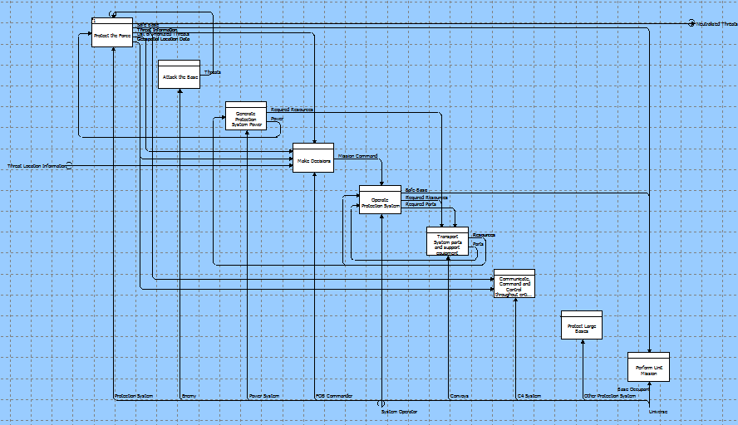
Level 0 – Metafunction

Slide 6
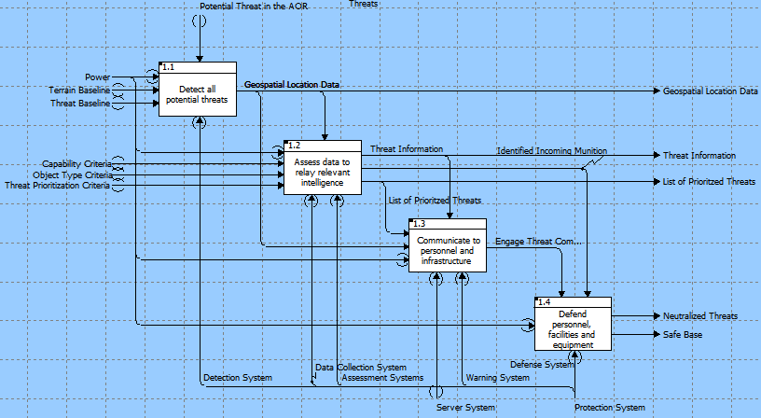
Level 1 – Protect the Base

Slide 7
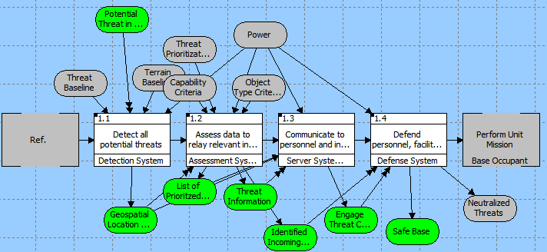
EFFBD– Protect the Base

Slide 8
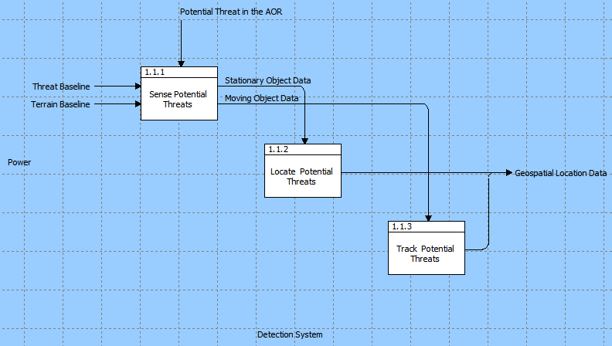
Level 2 – Detect Potential Threats

Slide 9
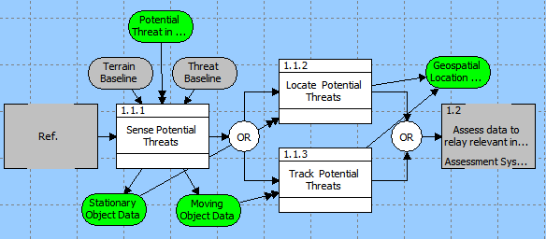
EFFBD– Detect Potential Threats

Slide 10
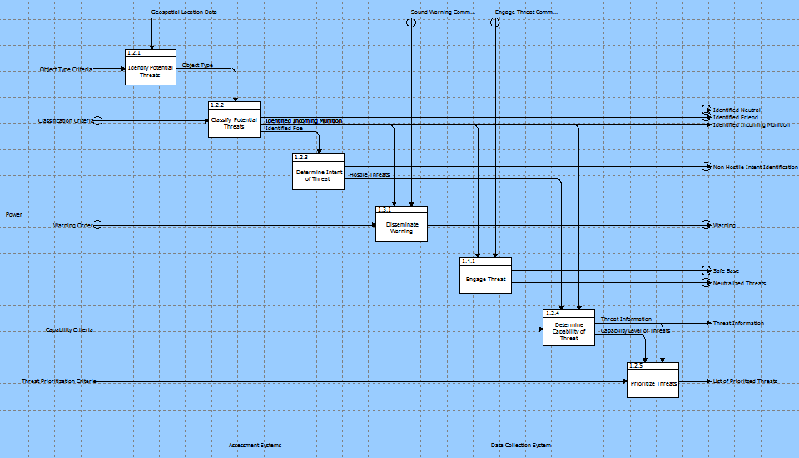
Level 2 – Assess Potential Threats

Slide 11
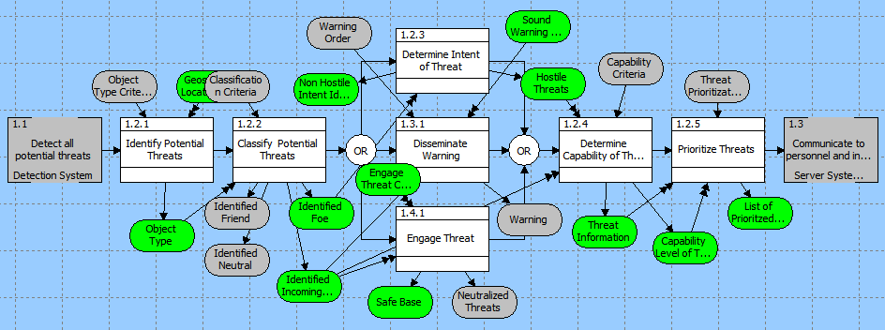
EFFBD – Assess Potential Threats

Slide 12
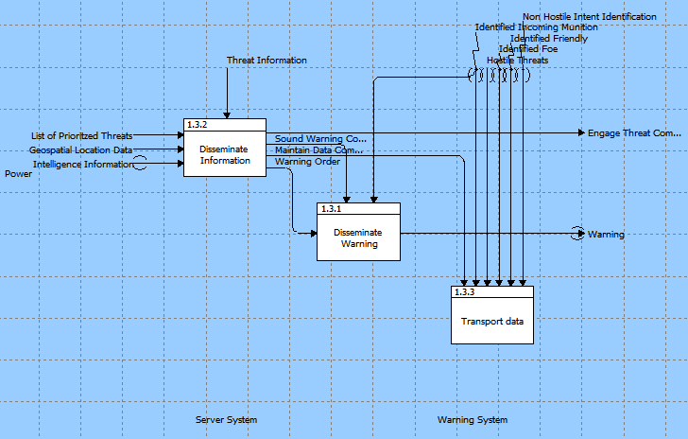
Level 2 – Communicate Information

Slide 13
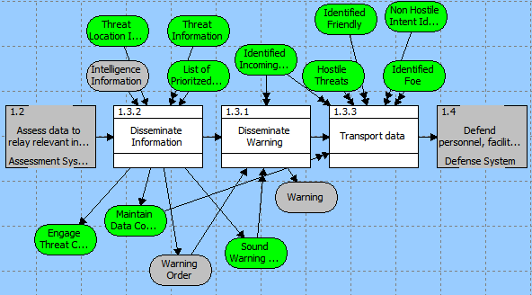
EFFBD – Communicate Information

Slide 14
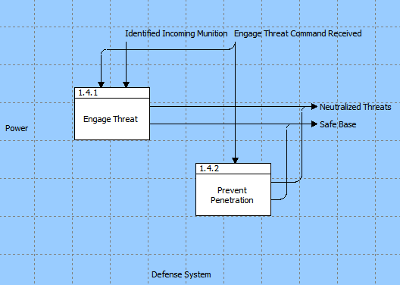
Level 2 – Defend Personnel, Facilities and Equipment

Slide 15
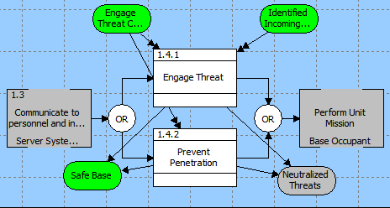
EFFBD – Defend Personnel, Facilities and Equipment

Slide 16
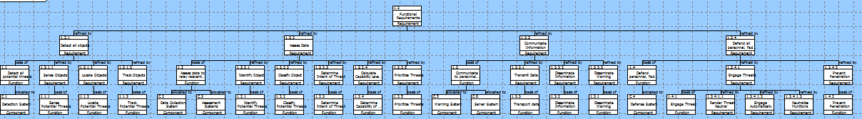
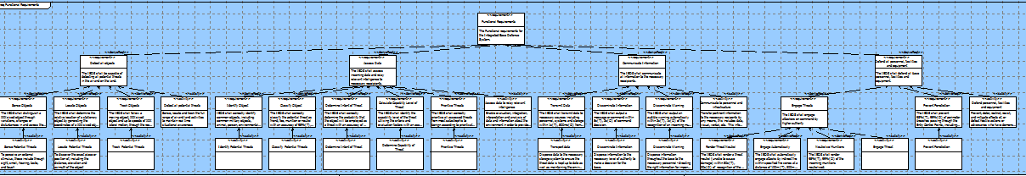
Alignment of Requirements and Functions

Slide 17
SV-5a

Slide 18
SV-5b

